Slide 1
5.6
The for Loop

Slide 2

The for Loop
Useful for counter-controlled loop
General Format:
  for(initialization; test; update)
  statement; // or block in { }
No semicolon after the update expression or after the )

Slide 3
for Loop - Mechanics
for(initialization; test; update)
  statement; // or block in { }
Perform initialization
Evaluate test expression
  If true, execute statement
  If false, terminate loop execution
Execute update, then re-evaluate test expression

Slide 4
for Loop - Example
int count;
for (count = 1; count <= 5; count++)
  cout << "Hello" << endl;

Slide 5
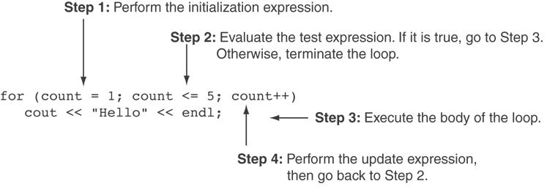
A Closer Look at the Previous Example

Slide 6
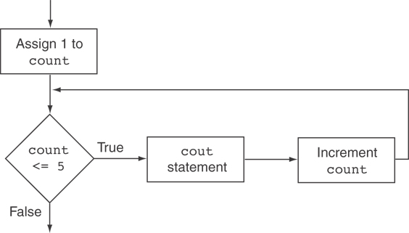
Flowchart for the Previous Example

Slide 7
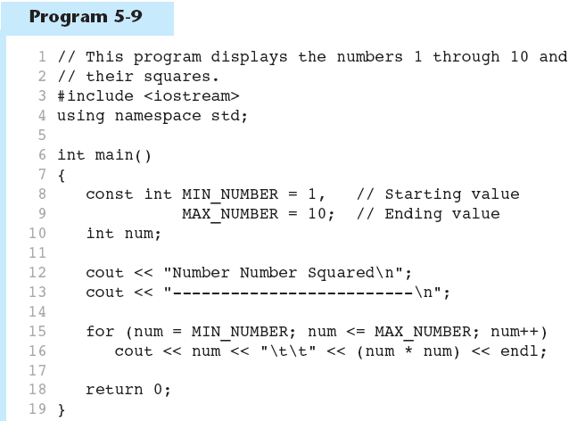
A for Loop in Program 5-9
Continued…

Slide 8
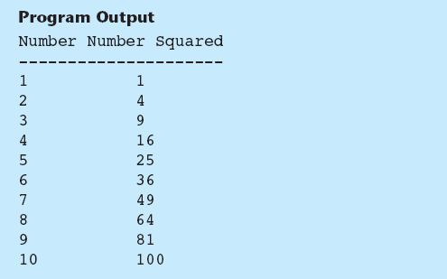
A for Loop in Program 5-9

Slide 9
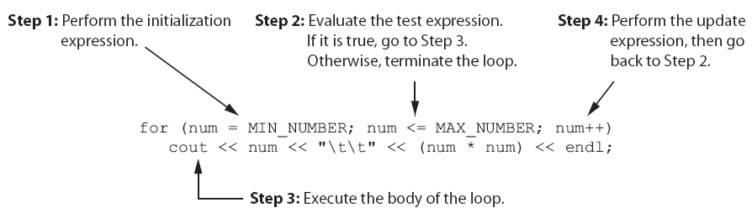
A Closer Look at Lines 15 through 16 in Program 5-9

Slide 10
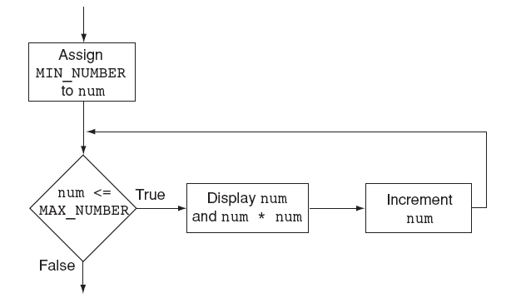
Flowchart for Lines 15 through 16 in Program 5-9

Slide 11
When to Use the for Loop
In any situation that clearly requires
  an initialization
  a false condition to stop the loop
  an update to occur at the end of each iteration

Slide 12
The for Loop is a Pretest Loop
The for loop tests its test expression before each iteration, so it is a pretest loop.
The following loop will never iterate:
for (count = 11; count <= 10; count++)
cout << "Hello" << endl;

Slide 13
for Loop - Modifications
You can have multiple statements in the initialization expression. Separate the statements with a comma:
int x, y;
for (x=1, y=1; x <= 5; x++)
{
cout << x << " plus " << y
<< " equals " << (x+y)
<< endl;
}
Initialization Expression

Slide 14
for Loop - Modifications
You can also have multiple statements in the test expression. Separate the statements with a comma:
int x, y;
for (x=1, y=1; x <= 5; x++, y++)
{
cout << x << " plus " << y
<< " equals " << (x+y)
<< endl;
}
Test Expression

Slide 15
for Loop - Modifications
You can omit the initialization expression if it has already been done:
int sum = 0, num = 1;
for (; num <= 10; num++)
sum += num;

Slide 16
for Loop - Modifications
You can declare variables in the initialization expression:
  int sum = 0;
  for (int num = 0; num <= 10; num++)
  sum += num;
  The scope of the variable num is the for loop.

Slide 17
5.9
Deciding Which Loop to Use

Slide 18
Deciding Which Loop to Use
The while loop is a conditional pretest loop
  Iterates as long as a certain condition exits
  Validating input
  Reading lists of data terminated by a sentinel
The do-while loop is a conditional posttest loop
  Always iterates at least once
  Repeating a menu
The for loop is a pretest loop
  Built-in expressions for initializing, testing, and updating
  Situations where the exact number of iterations is known

Slide 19
5.10
Nested Loops

Slide 20
Nested Loops
A nested loop is a loop inside the body of another loop
Inner (inside), outer (outside) loops:
  for (row=1; row<=3; row++) //outer
  for (col=1; col<=3; col++)//inner
  cout << row * col << endl;

Slide 21
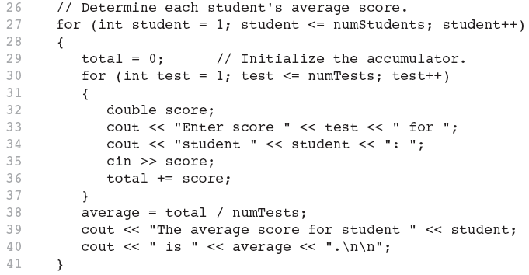
Nested for Loop in Program 5-14
Inner Loop
Outer Loop

Slide 22
Nested Loops - Notes
Inner loop goes through all repetitions for each repetition of outer loop
Inner loop repetitions complete sooner than outer loop
Total number of repetitions for inner loop is product of number of repetitions of the two loops.

Slide 23
5.12
Breaking and Continuing a Loop

Slide 24
Breaking Out of a Loop
Can use break to terminate execution of a loop
Use sparingly if at all – makes code harder to understand and debug
When used in an inner loop, terminates that loop only and goes back to outer loop

Slide 25
The continue Statement
Can use continue to go to end of loop and prepare for next repetition
  while, do-while loops: go to test, repeat loop if test passes
  for loop: perform update step, then test, then repeat loop if test passes
Use sparingly – like break, can make program logic hard to follow

